Slide 1
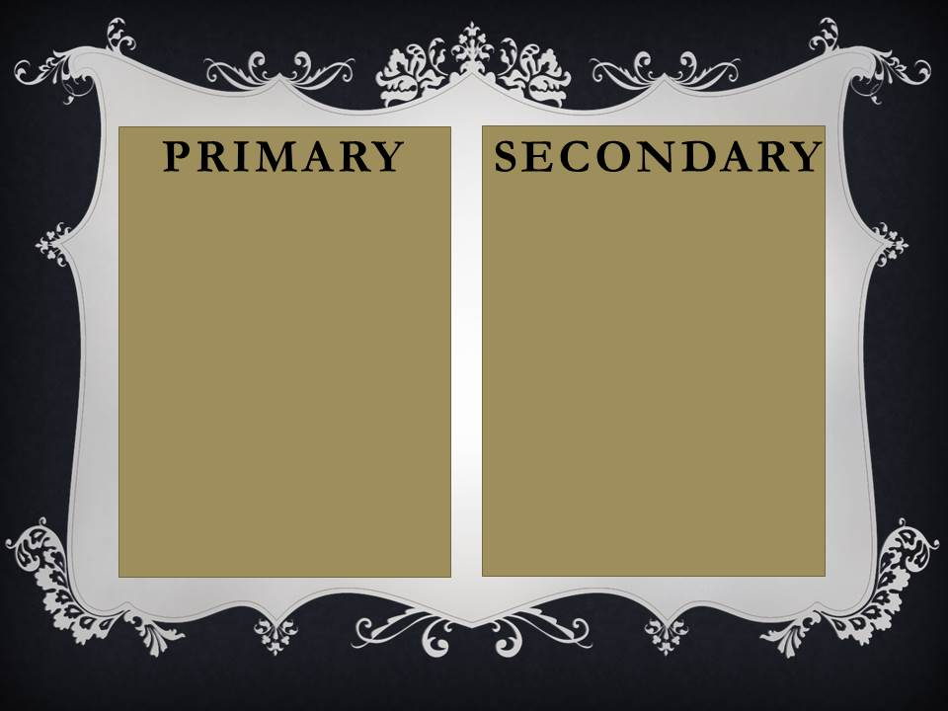
The diary of Christopher Columbus
Letters between a crew and their families
An arrowhead made by the Cherokee Indians
A social studies textbook
A speech given by a historian
A wood carving created by the king of Spain
A Wikipedia article on the Civil War
A movie review by a critic
A research paper published by a college
Ferdinand Magellan's ship log
Population/census records
Home video recordings of your childhood
A video documentary about the Civil War
A cannon from the 1400’s
Coins & gold found in a buried chest
Commentary/transcripts from a Supreme Court case

