Slide 1
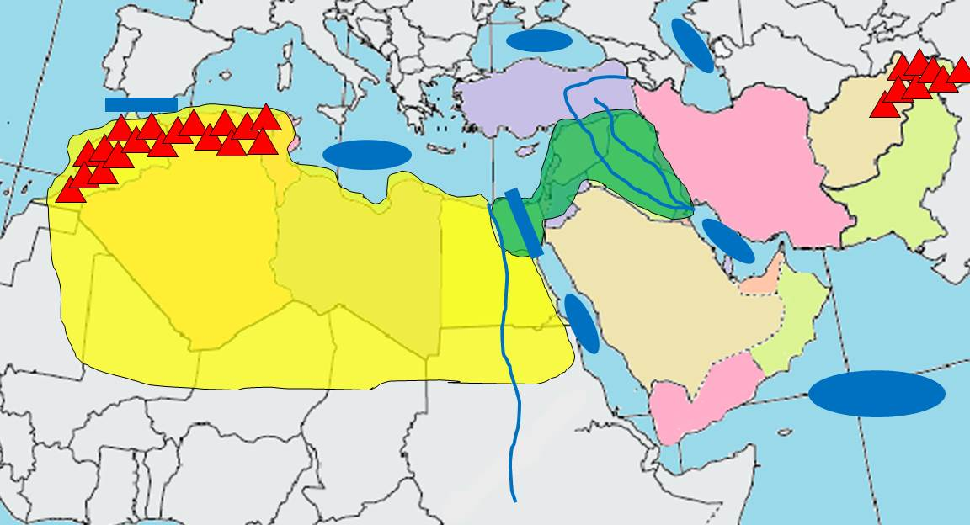
RED SEA
SAHARA DESERT
BLACK SEA
ARABIAN SEA
CASPIAN SEA
PERSIAN GULF
NILE RIVER
FERTILE CRESCENT
TIGRIS RIVER
STRAIT OF GIBRALTER
SUEZ CANAL
ATLAS MOUNTAINS
MEDITERRANEAN SEA
EUPHRATES RIVER
HINDU KUSH MOUNTAINS

Slide 2
RED SEA
SAHARA DESERT
BLACK SEA
ARABIAN SEA
CASPIAN SEA
PERSIAN GULF
NILE RIVER
FERTILE CRESCENT
TIGRIS RIVER
STRAIT OF GIBRALTER
SUEZ CANAL
ATLAS MOUNTAINS
MEDITERRANEAN SEA
EUPHRATES RIVER
HINDU KUSH MOUNTAINS

Slide 3
RED SEA
SAHARA DESERT
BLACK SEA
ARABIAN SEA
CASPIAN SEA
PERSIAN GULF
NILE RIVER
FERTILE CRESCENT
TIGRIS RIVER
STRAIT OF GIBRALTER
SUEZ CANAL
ATLAS MOUNTAINS
MEDITERRANEAN SEA
EUPHRATES RIVER
HINDU KUSH MOUNTAINS

Slide 4
RED SEA
SAHARA DESERT
BLACK SEA
ARABIAN SEA
CASPIAN SEA
PERSIAN GULF
NILE RIVER
FERTILE CRESCENT
TIGRIS RIVER
STRAIT OF GIBRALTER
SUEZ CANAL
ATLAS MOUNTAINS
MEDITERRANEAN SEA
EUPHRATES RIVER
HINDU KUSH MOUNTAINS

