Slide 1
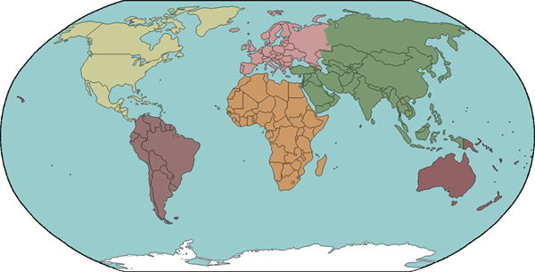
INDIAN OCEAN
ANTARTICA
ASIA
ATLANTIC OCEAN
PACIFIC OCEAN
ARCTIC OCEAN
NORTH AMERICA
AUSTRALIA
SOUTH AMERICA
EUROPE
AFRICA

Slide 2
INDIAN OCEAN
ANTARTICA
ASIA
ATLANTIC OCEAN
PACIFIC OCEAN
ARCTIC OCEAN
NORTH AMERICA
AUSTRALIA
SOUTH AMERICA
EUROPE
AFRICA

Slide 3
INDIAN OCEAN
ANTARTICA
ASIA
ATLANTIC OCEAN
PACIFIC OCEAN
ARCTIC OCEAN
NORTH AMERICA
AUSTRALIA
SOUTH AMERICA
EUROPE
AFRICA

