Slide 1
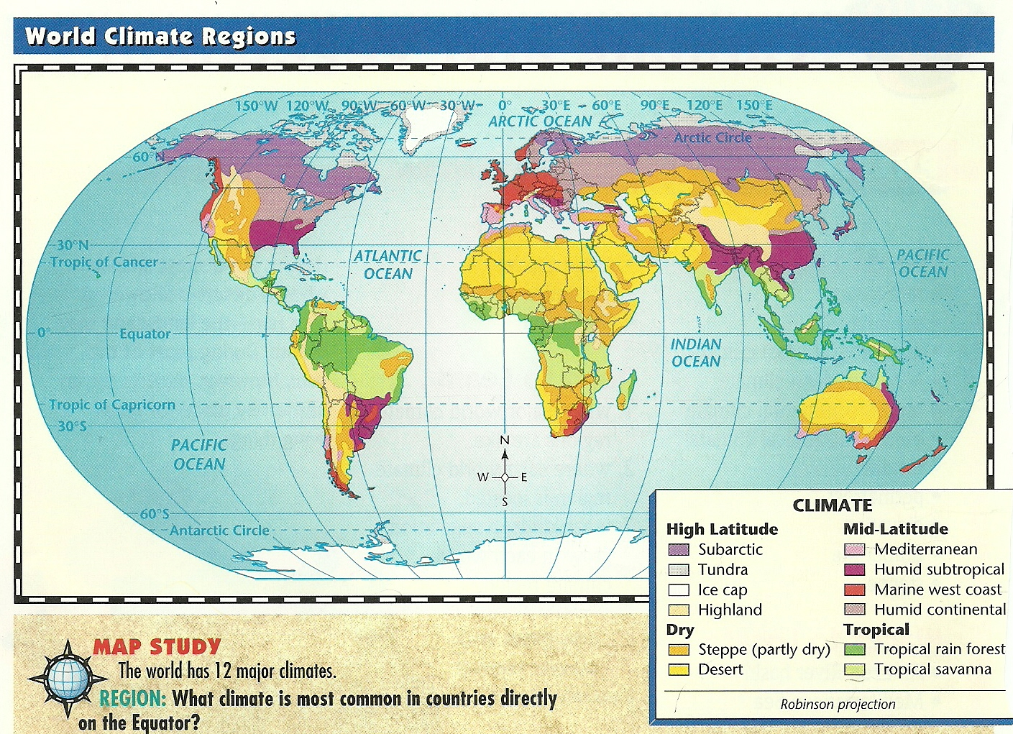
POLAR ZONE
TEMPERATE ZONE
TROPICAL ZONE
TROPICAL ZONE
TEMPERATE ZONE
POLAR ZONE
Do you notice a pattern? Explain….

Slide 2
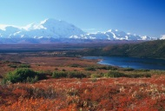
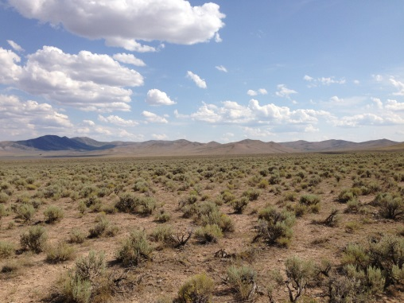
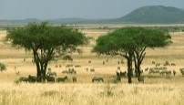
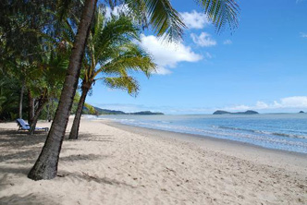
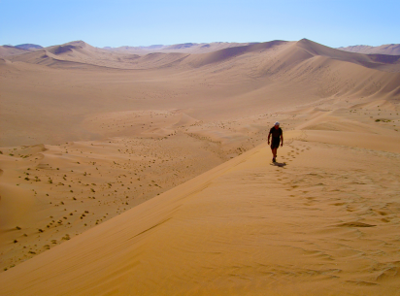
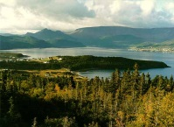
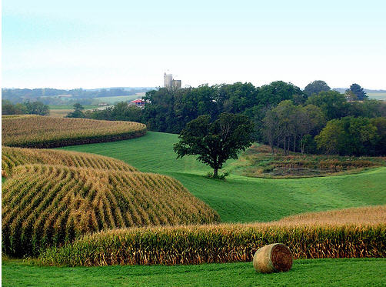
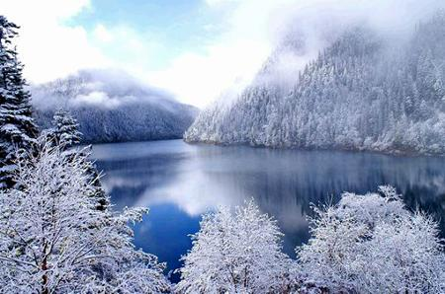
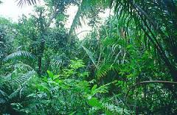
Heavy rain during summer months; short-mild winters
Harsh and dry with permafrost; vast rolling plain without trees
Colorado / Australia
DESERT (ARID)
Humid Subtropical
Most of the Midwest
TEMPERATE
Wet and dry seasons; broad grasslands with few trees
Lush vegetation; 100+ inches of rain a year
Serengeti - Africa
Marine West Coast
POLAR ZONE
Tundra
Florida
Less than 10 inches of rain a year; scattered plants like cacti
POLAR ZONE
TEMPERATE
Desert
Middle East
TROPICAL ZONE
Tropical Rainforest
TEMPERATE
Most of Canada
Humid Continental
Northern Russia / Greenland
Severely cold-bitter winters; huge evergreen (pine) trees
TROPICAL ZONE
DESERT (ARID)
Steppe
Tropical Savanna
Partly dry grasslands; 10-20 inches of rain a year
Subarctic
Washington / Oregon
Amazon - Brazil
Ocean winds; rainy-mild winters, cool summers
Four seasons; long-cold winters, short-hot summers

Slide 3
Do you consider yourself a Disney buff? Based on the location of these classics, see how well you can match them to the correct climate type!
Humid Subtropical
Marine West Coast
Tundra
Desert
Tropical Rainforest
Humid Continental
Tropical Savanna
Steppe
Subarctic

