Slide 1
OPERATION: RESETTLEMENT
UNDERSTANDING TIMES ZONES

Slide 2
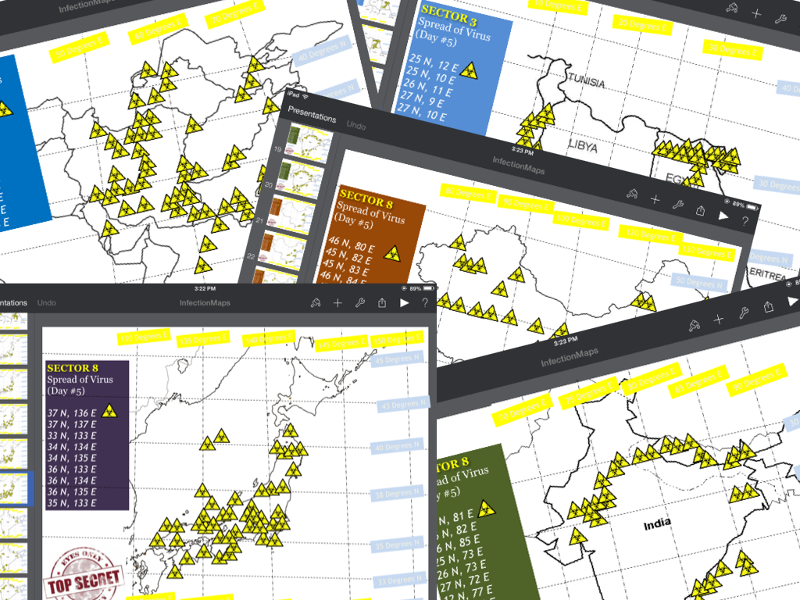
OPERATION: RESETTLEMENT
Operation Containment was successful. Sector populations have been determined.
For the time being, the epidemic has ceased expanding. It is time to begin OPERATION: RESETTLEMENT.
"PERMANENT" SAFE ZONES

Slide 3
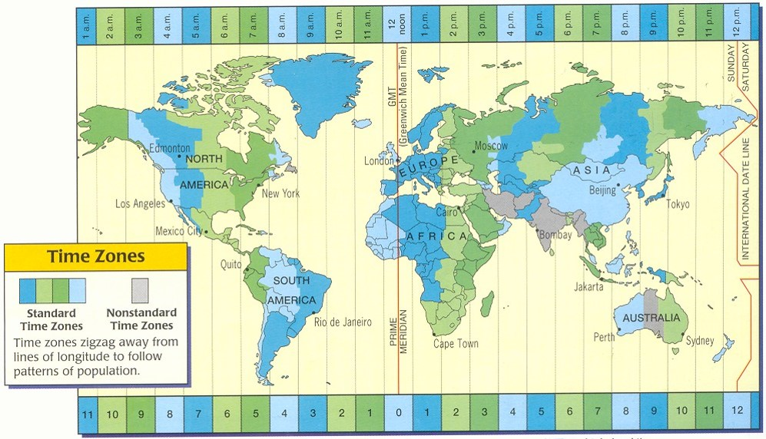
OPERATION: RESETTLEMENT
Sectors will need to communicate with each other. In order to do this, your team needs to understand time zones.
Using earbuds, watch the video by clicking the arrow.

Slide 4
Earlier than Greenwich time
Later than Greenwich time
Greenwich Standard Time
Negative
Positive
Try to explain to yourself "why" several ideas have been added to this map...What are they trying to help you understand when using this map?
Can you use this map to determine times in different countries. The next slide will give you the chance to practice. Good luck!

Slide 5
If it is 12:00 noon in Greenwich, what time is it in Mexico City?
ANSWER?
If it is 12:00 noon in Greenwich, what time is it in Sydney?
ANSWER?
If it is 9:00 AM in Cape Town, what time is it in Tokyo?
ANSWER?
If it is 2:00 pm in New York, what time is it in Moscow?
ANSWER?

Slide 6
LET'S SEE HOW YOU DID?
Check your answers here!
World Studies – Mrs. Dahlgren

