Slide 1
What if…
ALIENS LANDED?

Slide 2
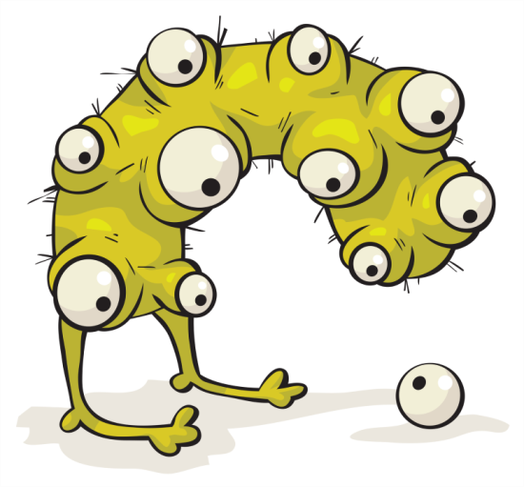
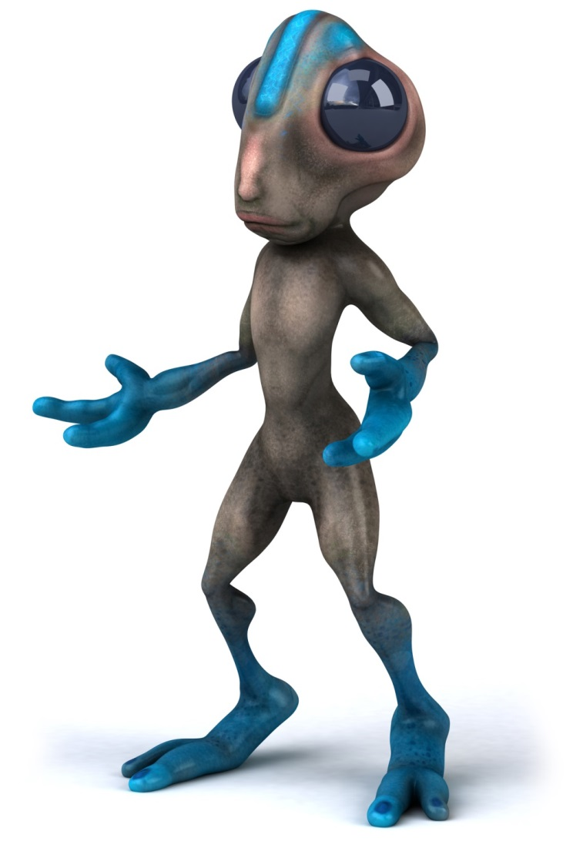
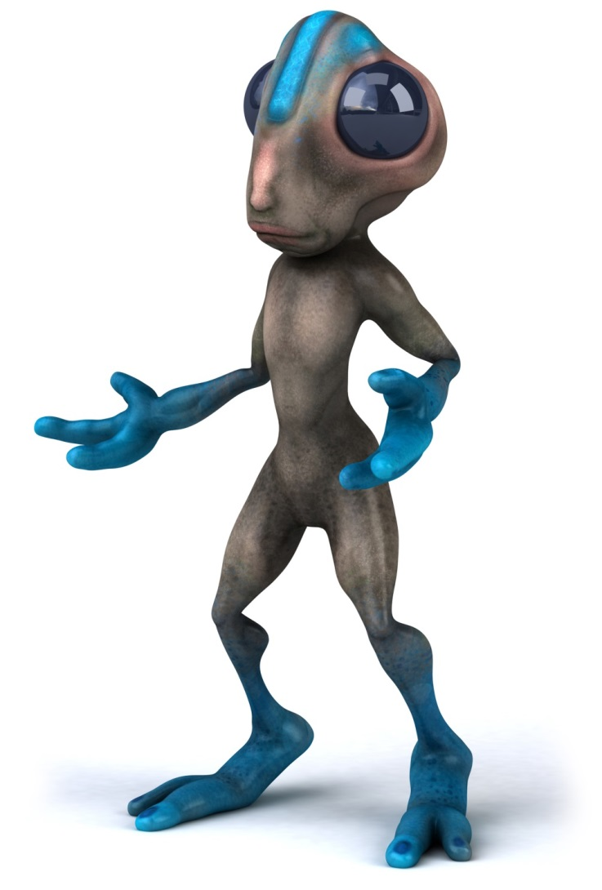
Where can these aliens survive?!?
Save
Us!

Slide 3
ALIENS HAVE CRASH LANDED ON EARTH Your job is to help them survive!
Your Mission:
Read the alien characteristics.
On the last slide, decide which climate each alien can survive in and drag and drop the alien onto that climate.
You may use your climate notes & your textbook to complete this mission.

Slide 4
Skin Color
Vision
Skin will change color depending on level of humidity in order to blend in with the environment for protection from predators. (More humidity means easier ability to change colors)
Due to direct sun rays, Alien has limited vision and is susceptible to night blindness.
Alien Diet
Vocal Abilities
Alien’s diet consists of 50% fresh water and 30% salt water. Must consume 20 eight oz. cups of water daily. Alien eats plant life similar to indigenous like primates.
Able to mimic sounds and make calls in environment to manipulate other animals as needed to survive.
Body Temperature
Special Abilities
Aliens body temperature must average 20 degrees higher than a human in order to survive.
Can quadruple the mass of arachnids in order to hunt, gather, and travel.
Appendages
Weaknesses
Supplemental nutrients are absorbed through the phalanges of all appendages .
Due to colorful skin covering, cannot survive in polar climate zones. Needs dense foliage to evade predators.
Terrain
Alien’s hands and feet are well equipped for climbing and/or walking on any terrain. Prefers climbing into canopies.
ALIEN CHARACTERISTICS

Slide 5
Skin Color
Vision
Wide variations in sunlight exposure results in Alien’s skin being a neutral color to shield him from predators.
Alien lacks depth perception, which makes him more likely to run into objects.
Vocal Abilities
Alien Diet
Can manipulate movements of objects to create symbols for purpose of communication.
Needs to consume approximately 8 pounds of conifer needles every day to maintain body weight.
Special Abilities
Body Temperature
Extreme coldness allows for the ability to blind prey.
His body must contain a core temperature similar to that of Ursus arctos horribilis. Hibernates by converting lower air temperatures to energy though the bulge in his head. Higher temperatures result in suffocation.
Weaknesses
Cannot self-reproduce if located within a climate that has four seasons.
Appendages
High humidity allows for the high voltage of electricity through the tentacles for defensive purposes.
Terrain
Given uneven lower appendages, species moves best on flakes of crystalline water ice.
ALIEN CHARACTERISTICS

Slide 6
Skin Color
Vision
Fur continuously grows. Must have adequate moisture to shed fur. Without necessary rainfall, alien will suffocate on his own fur.
Similar to amphibians, alien is able to look in multiple direction simultaneously In order to avoid oncoming obstacles.
Vocal Abilities
Alien Diet
Uses to echolocation to communicate with others by bouncing signals off of ocean tides.
Diet must be 30% freshwater and 10% salt water. Can store water for up to 6 months. Needs to consume 24 smaller mammals (size of rodents) hourly.
Special Abilities
Has the ability to read the minds of his prey under dangerous weather conditions.
Body Temperature
Alien needs a variety of at least two seasons to allow his fluffy body to sustain a critical body temperature.
Weaknesses
Susceptible to larger birds of prey. Needs tall foliage to evade predators. Needs to gnaw on jade/limestone to prevent overgrowth of fangs.
Appendages
In mild climates able to smell prey from 12 miles away. Cloud cover increases ability by 67%. Extreme winds cause difficulty during flight because of horns.
ALIEN CHARACTERISTICS

Slide 7
Skin Color
Vision
Arid climates allows skin to become translucent for self defense. Skin behaves like a plant cell in regards to photosynthesis.
In order to survive extreme sunlight, aliens eye fluid secretion prevents blistering and burning.
Alien Diet
Vocal Abilities
Drastic changes in temperature results in eyeball implosion. Able to survive solely on these shed eyeballs. Little to no water needed, as moisture is absorbed through consumed eyeballs.
In wind, hairs vibrate in a way that creates musical resonance which can be felt by similar alien’s hair follicles.
Special Abilities
When threatened, Alien expels thorns, similar to Cactaceae, through pores in order to blend into environment. Also uses them to burrow into loose soil for long periods of slumber.
Body Temperature
Needs one-seasoned climate in order to sustain adequate body temperature. Must burrow in ground to thrive.
Appendages
Weaknesses
Alien walks on his upper-extremities. Alien can only move by doing flips. Landing on any hard surface will result in broken arms.
Lacks speed; will be competing with serpents, reptiles and small mammals for resources. Tends to relate with arachnids.
ALIEN CHARACTERISTICS

Slide 8
Skin Color
Vision
Needs a climate with a variation of precipitation and humidity to control the creature’s hue.
Alien is blind. They have eyes, but they are non-functional.
Vocal Abilities
In wind, alien can send out cooing/warbling noises.
Alien Diet
Able to absorb only freshwater through gelatinous orifices. Prefers a diet of various aviary creatures.
Special Abilities
Requires fluctuations in temperatures and precipitation at least every 3 months in order to project large amounts of gastrointestinal fluid up to 25 meters.
Body Temperature
Body temperature is very flexible. Alien’s temperature can vary anywhere from the temperature of Villa Las Estrellas, Antarctica to Dallol, Ethiopia.
Weaknesses
Arid air dissolves alien’s life form and will result in alien becoming a pool of bodily fluid.
Appendages
Alien slithers across terrain using its arms to pull it and leaves a sticky trail behind him to trap prey.
Weaknesses
Slithering across coarse terrain will result in the erosion of his lower body. Alien needs forgiving land. Able to move best on land suitable for bovine mammals.
ALIEN CHARACTERISTICS

Slide 9
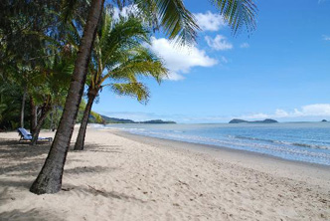
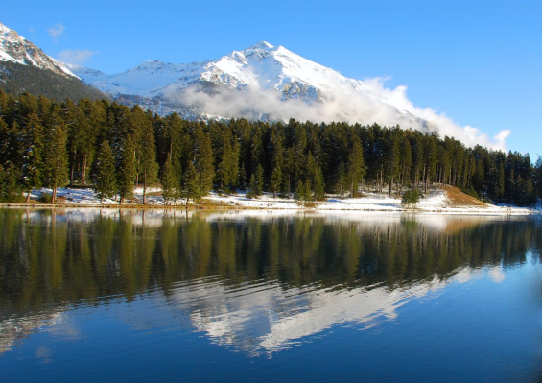
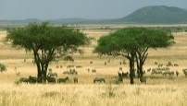
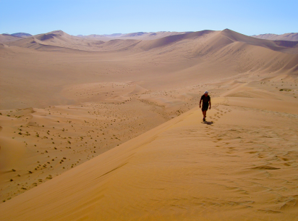
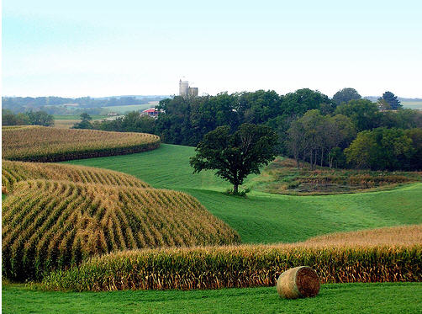
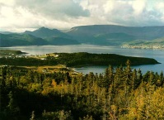
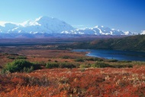
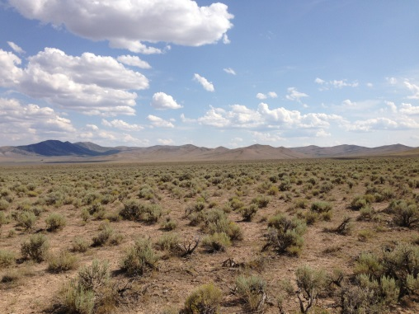
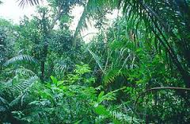
Humid Subtropical
Subarctic
Tropical Savanna
Desert
Humid Continental
Marine West Coast
Tundra
Tropical Rainforest
Steppe

